Slide 1
Effects of Social Media on Teen Depression and Suicide
Roxanna Teeling MAS, LMSW

Slide 2
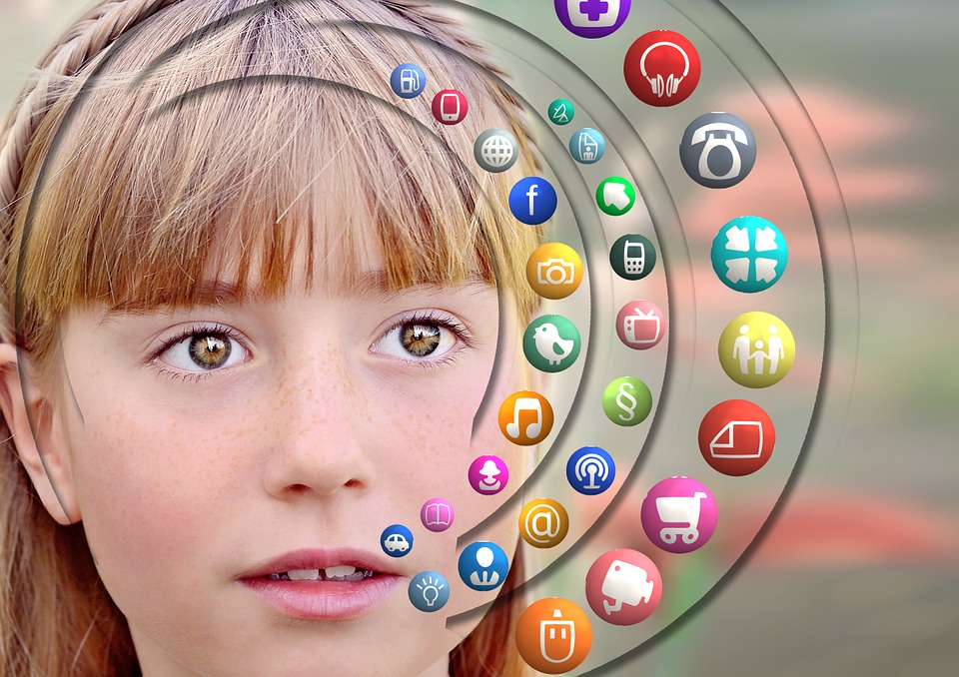
Survey
Are you female?
Do you own a smartphone?
Did you get your phone before the age of 14?
Do you spend more than 30 minutes at a time on social media?
Do you spend more than 2 hours per day on social media?
Is your phone, computer, IPad, TV in your room when you sleep?
Do you compare yourself to other people your age?
Are you rested when you wake up, ready to start the day?
Do you feel isolated, lonely, or left out some of the time?
Have you ever felt depressed or had thoughts of suicide?

Slide 3
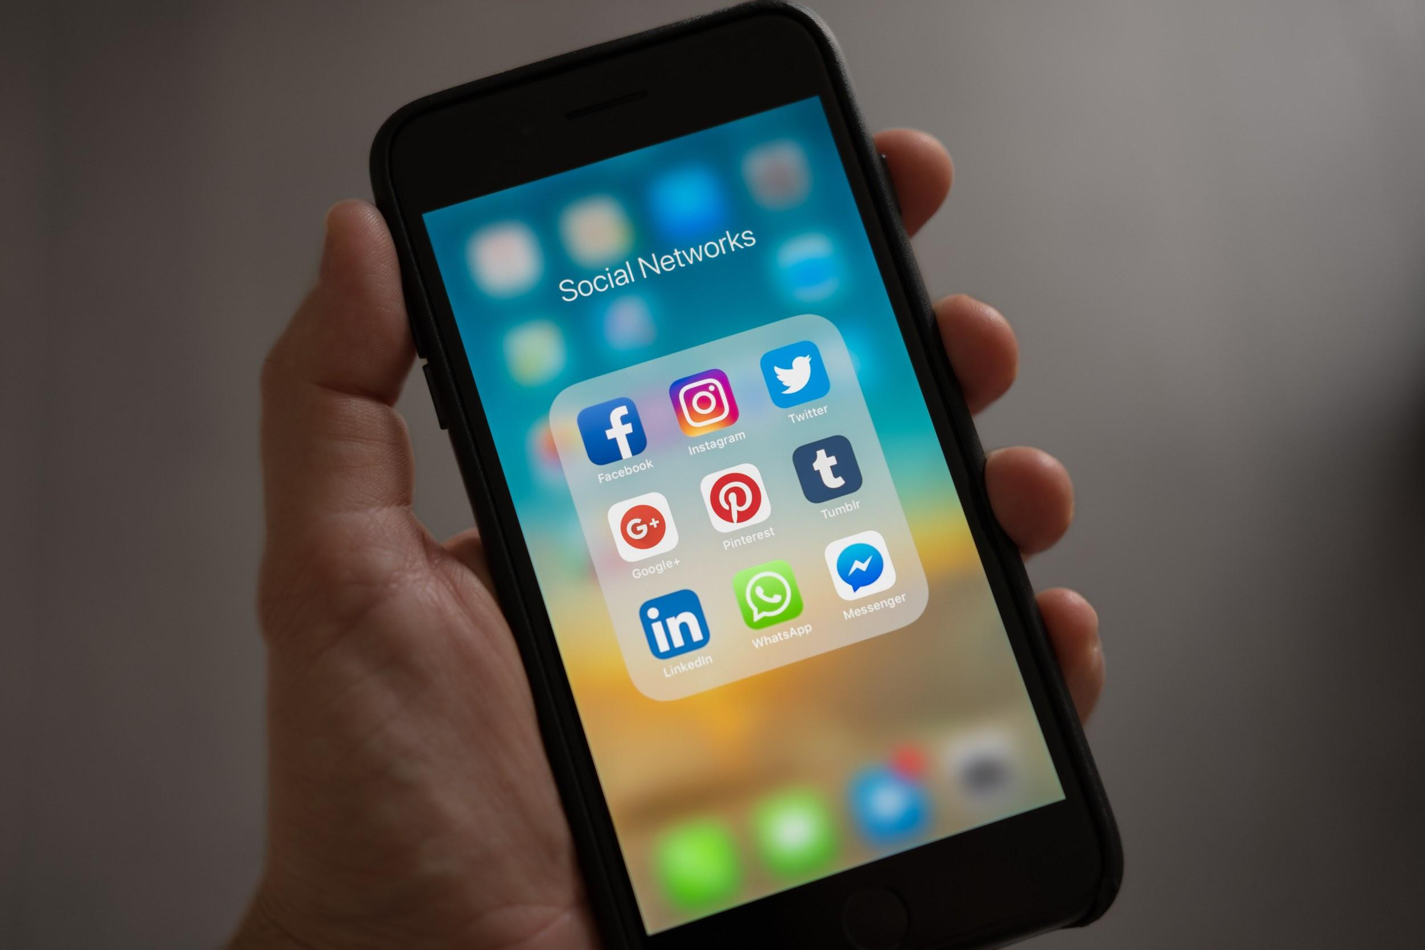
Statistics
92% of teens own a smartphone
Of those studied with high rates of social media use -up to 66% of teens and young adults reported depression
Over half a million 8-12 graders studied -exhibited high levels of depression increased by 33% -in this same study the suicide rate for girls increased by 65%
Increase of young adults seeking counseling specifically for depression by 30%
A study reported in the JAMA of Pediatrics, July of 2019 shows evidence that social media causes depression
This research also shows, each one-hour period on social media can significantly increase depression
Brain mapping shows the brain reward center responds with each "like" or "heart" essentially acting just like a substance - dopamine burst

Slide 4
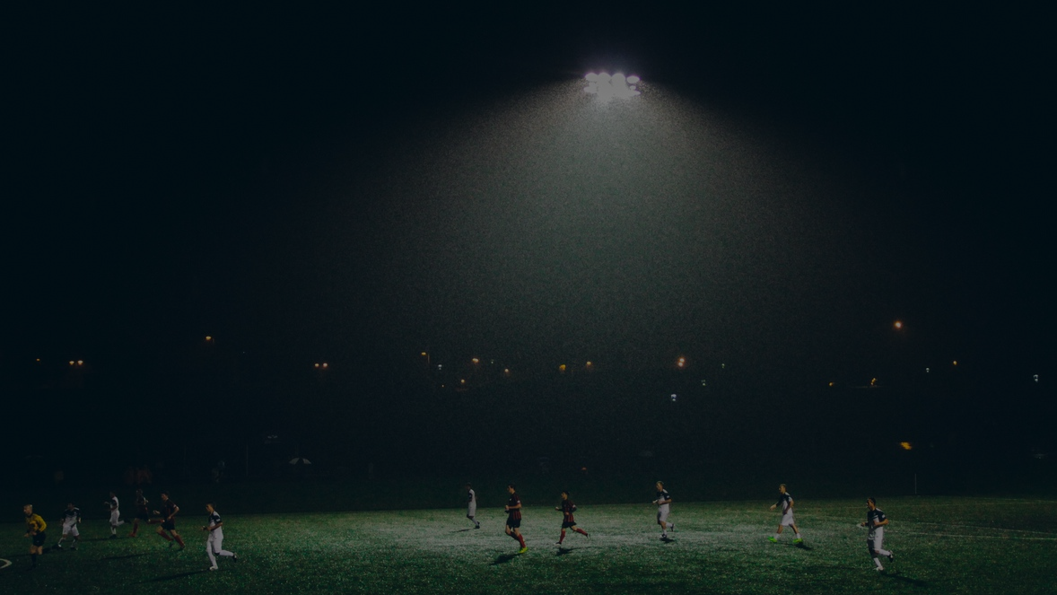
What are the risks?
Increased depression
Increased thoughts and completion of suicide
Less healthy activity (physical, learning, development)
Sleep deprivation (melatonin disruption, interrupted sleep, less REM sleep)
Lower self esteem (comparison to others, curated images: prettier, richer, thinner, popular, fear of being rejected
Blue light
All devices have blue lights. The blue lights shut off the pineal gland in the brain which produces melatonin. Melatonin is the chemical that makes us sleepy and starts the process to physically prepare for a good night's rest.

Slide 5
Risk Factors
Owning a phone Before the age of 14
Time Spending 30 minutes or more on social media at a time, more than 2 hours per day
Sleep Using social media one hour prior to bed
Alarms Set an alarm to help keep you to your limits of 30/2
Female Being a female increases the risk of depression by 33% and suicide by 65%
Connection Minimal connection face to face

Slide 6
People saying social media causes depression
Dr. Twenge PhD. of SDSU
Professor of Psychology 2019
JAMA Pediatrics
Boers PhD.,
Afzali PhD., Newton PhD
2019
Dr. Melissa Hunt PhD. of
Pennsylvania 2018

Slide 7
Tips for better health
Charging station Set up a charging station where all devices go one hour prior to bed
Bedroom No devices in the bedroom
Limits No more than 30 minutes at a time. No more than 2 hours per day
Alarms Set an alarm to help keep you to your limits of 30/2
Face to face Make plans with others and engage in activities
Balance Create a balance in activities

Slide 8
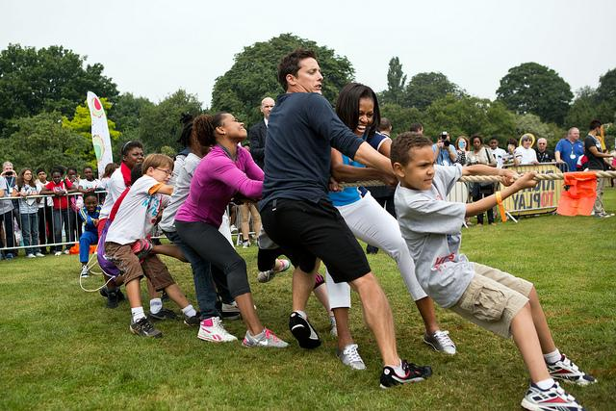
Reach out!
SAMHSA’s National Helpline, 1-800-662-HELP (4357), (also known as the Treatment Referral Routing Service) or TTY: 1-800-487-4889 is a confidential, free, 24-hour-a-day, 365-day-a-year, information service, in English and Spanish, for individuals and family members facing mental and/or substance use disorders.
Suicide and Crisis Hotlines by County
Maricopa County served by Mercy Care: 1-800-631-1314 or 602-222-9444
Cochise, Graham, Greenlee, La Paz, Pima, Pinal, Santa Cruz and Yuma Counties served by Arizona Complete Health - Complete Care Plan: 1-866-495-6735
Apache, Coconino, Gila, Mohave, Navajo and Yavapai Counties served by Steward Health Choice Arizona: 1-877-756-4090
Gila River and Ak-Chin Indian Communities: 1-800-259-3449
Salt River Pima Maricopa Indian Community: 1-855-331-6432
You can also TEXT 741741 - and text a counselor at anytime
First, you’re in crisis. That doesn’t just mean suicide: it’s any painful emotion for which you need support. You text us at 741741

